Slide 1
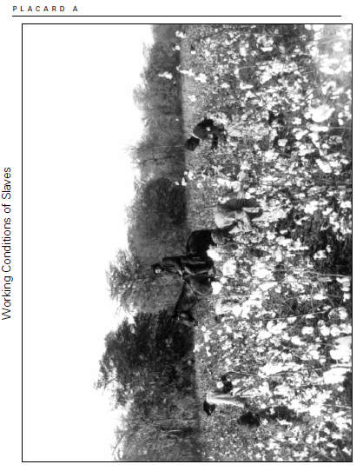
20.4 Working Conditions
Quotation 8
Uncle Big Jake sho’ work de slaves from early mornin’ till night. When you is in de field you
better not lag none. When its fallin’ weather de hands is put to work fixin’ dis and dat. De
women what has li’l chillen don’t have to work so hard. Dey works ’round de sugar house
and come 11 o’clock dey quits and cares for de babies till 1 o’clock, and den works till 3 o’clock
and quits.
—Sarah Ford
(ex-slave, Texas)
Uncle Big Jake sure worked the slaves from early morning till night. When you are in
the field, you’d better not lag behind. When it is raining or snowing the hands are put to
work fixing this and that. The women who have little children don’t have to work so hard.
They work round the sugar house and at 11 o’clock they quit and care for the babies until
1 o’clock, and then they work until 3 o’clock and quit.

Slide 2
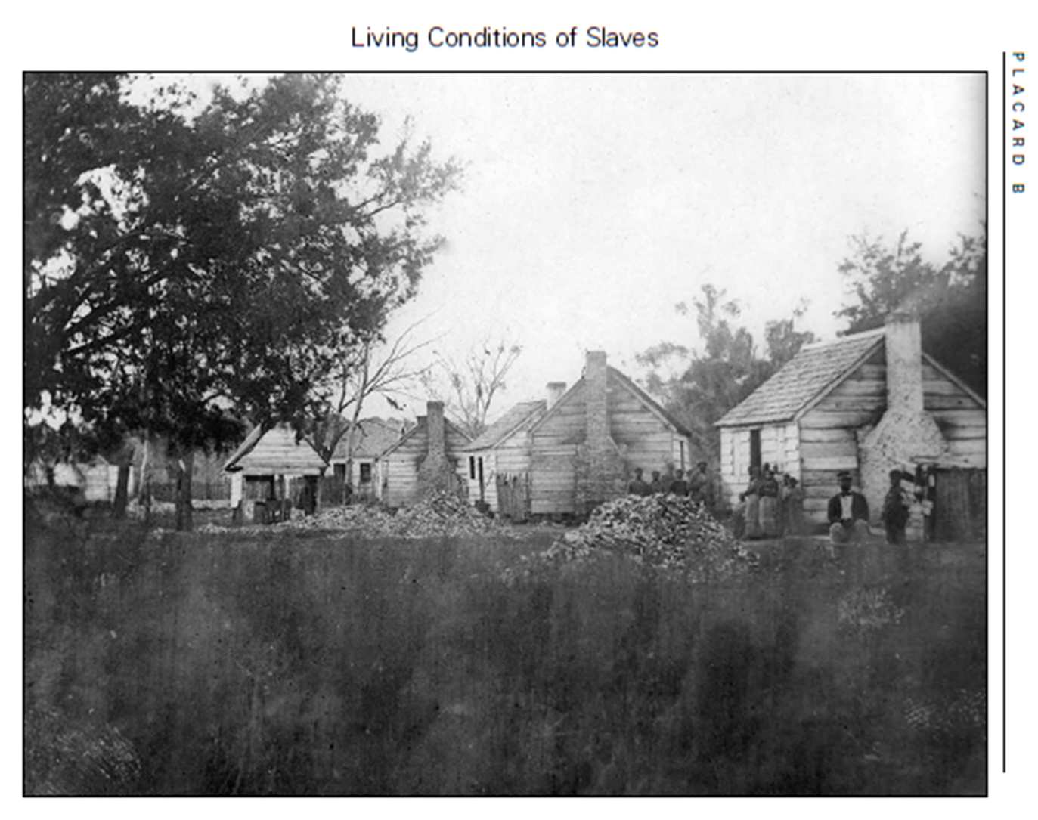
20.5 Living Conditions
Quotation 1
We had old ragged huts made out of poles, and some of de cracks chinked up wid mud and
moss and some of dem wasn’t. We didn’ have no good beds, jes’ scaffolds nailed up to de wall
out of poles and de ole ragged buddin’ throwed on dem. Dat sho’ was hard sleepin’ but even
dat feel good to our weary bones after dem long hard days work in de field.
—Jenny Proctor
(ex-slave, Texas)
We had old ragged huts made out of poles, and some of the cracks were filled with mud and
moss, and some weren’t. We didn’t have any good beds, just scaffolds nailed up to the wall
made out of poles and old ragged bedding thrown on them. That sure was hard sleeping, but
even that felt good to our weary bones after those long hard days of work in the fields.

Slide 3
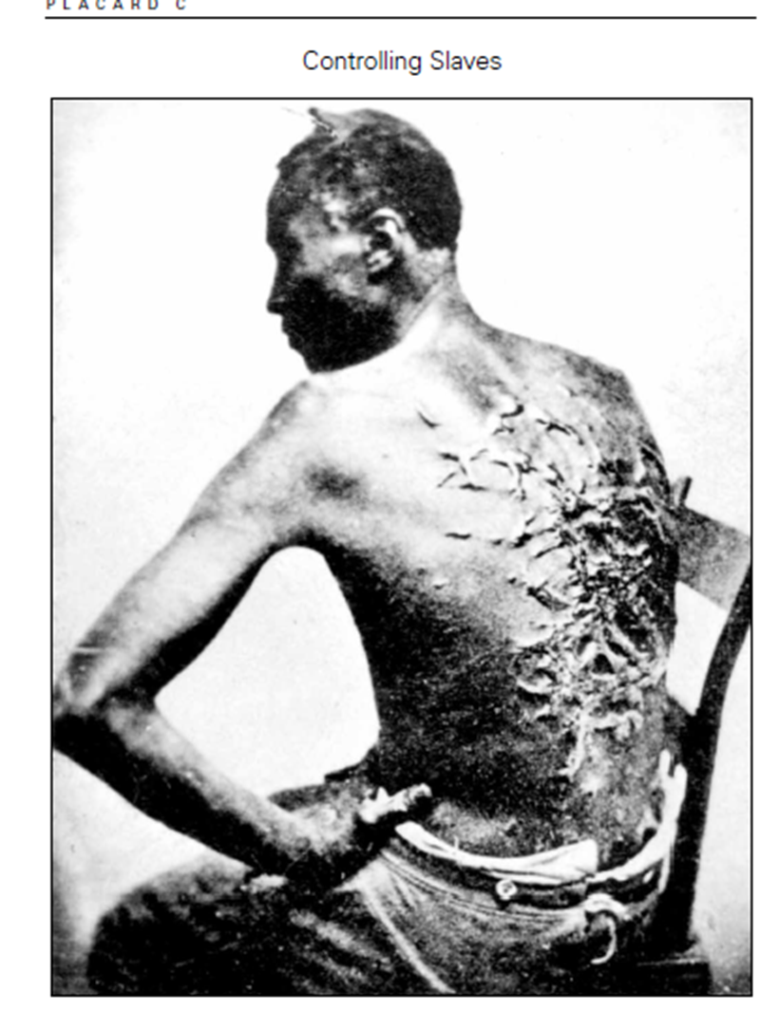
20.6 Controlling Slaves
Quotation 2
One ob de cruelest things I ever seen done to a slave wuz done by my Master. He wanted to punish one ob de slaves what had done some ’em dat he didn’t lak, a kinda stubborn one. He . . . hitched him to a plow an’ plowed him jes’ lak a hors. He beat him an’ jerked him ’bout ’till he got all bloody an’ sore, but ole Marse he kept right on day after day. Finally de buzzards went to flyin’ over ’em . . . dem buzzards kept a flyin’ an’ old Marse got to being haunted by dat slave an’ buzzards. He could alwas’ see ’em an’ hear de groans . . . an’ he was hainted dat way de res’ ob his life.
—Vinnie Busby
(ex-slave, Mississippi)
One of the cruelest things I ever saw done to a slave was done by my master. He wanted to
punish one of the slaves who had done something that he didn’t like. [The slave] was kind
of a stubborn one. He took that slave and hitched him to a plow and plowed him just like a
horse. He beat him and jerked him about until he got all bloody and sore, but the old master
kept right on day after day. Finally, the buzzards were flying over them . . . those buzzards
kept flying and the old master was haunted by that slave and the buzzards. He could always
see them and hear the groans . . . And he was haunted that way for the rest of his life.

Slide 4
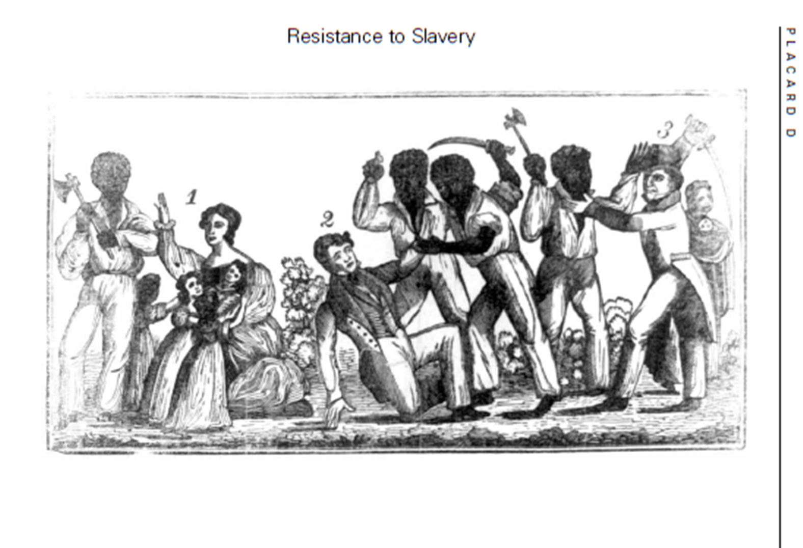
20.7 Resistance to Slavery
Quotation 7
And about this time I had a vision—and I saw white spirits and black spirits engaged in
battle, and the sun was darkened—the thunder rolled in the Heavens, and blood flowed in
streams . . . while labouring in the field, I discovered drops of blood on the corn as though
it were dew from heaven . . . And on the 12th of May, 1828, I heard a loud noise in the
heavens, and the Spirit instantly appeared to me and said the Serpent was loosened, and . . .
that I should take it on and fight against the Serpent, for the time was fast approaching when
the first should be last and the last should be first . . . And on the appearance of the [last] sign
(the eclipse of the sun last February), I should arise and prepare myself, and slay my enemies
with their own weapons.
—The Confessions of Nat Turner, 1831

Slide 5
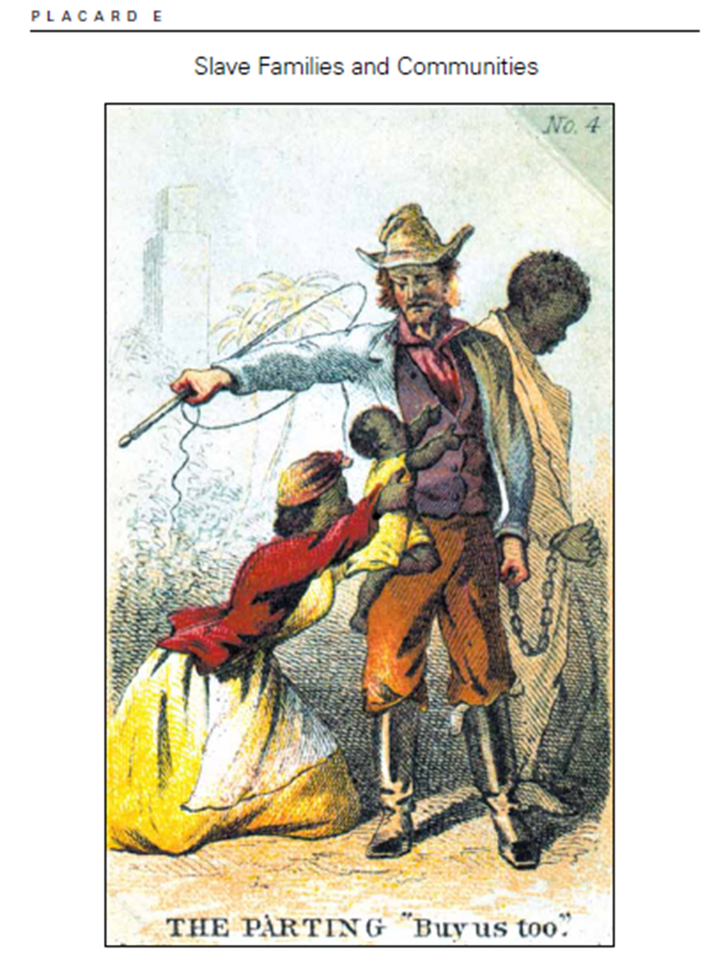
20.8 Slave Families and Communities
Quotation 4
My father wuz sold ’way from us when I wuz small. Dat wuz a sad time fer us. Mars wouldn’t
sell de mudders ’way from deir chillun so us lived on wid out de fear ob bein’ sold. My pa sho’
did hate ter leave us. He missed us and us longed fer him. He would often slip back ter us’
cottage at night. Us would gahter ’round him an’ crawl up in his lap, tickled slap to death, but
he give us dese pleasures at a painful risk. When his Mars missed him he would beat him all
de way home.
—Hannah Chapman
(ex-slave, Mississippi)
My father was sold away from us when I was small. That was a sad time for us. Master
wouldn’t sell the mothers away from their children, so we lived on without fear of being
sold. My Pa sure did hate to leave us. He missed us and we longed for him. He would
often slip back to our cottage at night. We would gather around him and crawl up in his
lap, and he tickled us for a long time. But he gave us these pleasures at a painful risk. When
his master missed him, he would beat him all the way home.

Slide 6
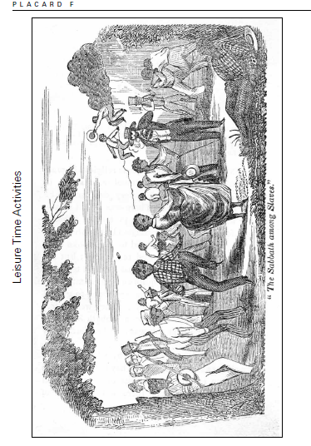
20.9 Leisure Time Activities
Quotation 5
Most times when slaves went to deir quarters at night, mens rested but sometimes dey holped
de ’omans cyard de cotton and wool. Young folkses frolicked, sung songs, and visited from
cabin to cabin. When dey got behind wid de field wuk, sometimes slaves wuked atter dinner
Saddays, but dat warn’t often. But, Oh, dem Sadday nights! Dat was when slaves got together
and danced. George, he blowed de quills, and he sho could blow grand dance music on ’em . . .
Dere warn’t no foolishment ’lowed after ten o’clock no night. Sundays dey went to church and
visited ’round, but folks didn’t spend as much time gaddin’ ’bout lak dey doesn now days.
—Georgia Baker
(ex-slave, Georgia)
Most of the time when slaves went to their quarters at night, men rested. But sometimes
they helped the women card the cotton and wool. Young folks frolicked, sang songs, and
visited from cabin to cabin. When they got behind with the fieldwork, sometimes slaves
worked after dinner on Saturdays, but that wasn’t often. But, oh, those Saturday nights!
That was when slaves got together and danced. George played an instrument [possibly a
harmonica], and he sure could blow grand dance music . . . Noisy activities were not allowed
after ten o’clock on any night. Sundays they went to church and visited each other, but folks
didn’t spend as much time gadding about [looking for a good time] like they do nowadays.

Slide 7
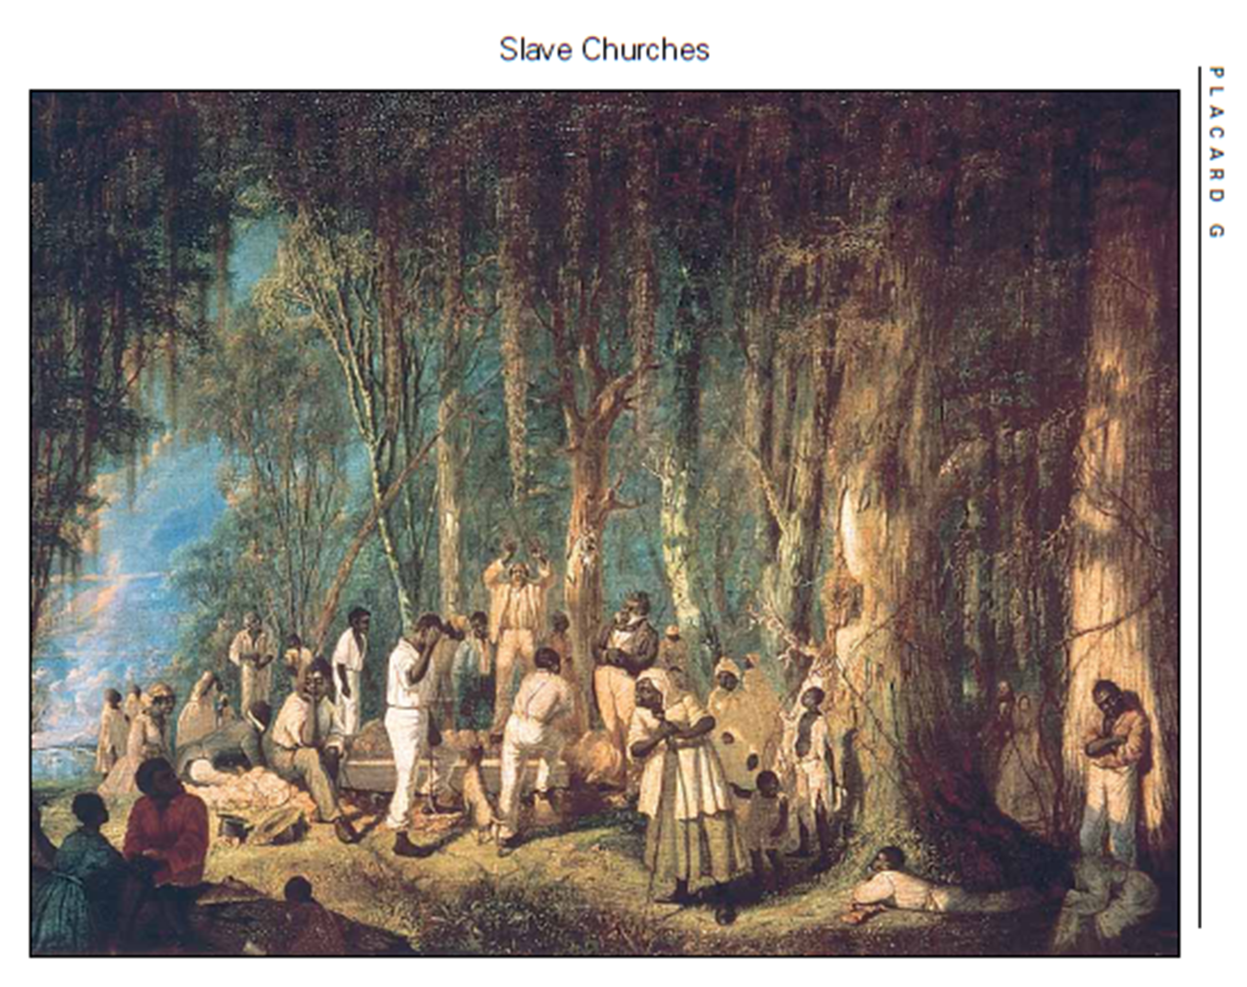
20.10 Slave Churches
Quotation 6
On Sundays . . . I have seen the negroes up in the country going away under large oaks, and
in secret places, sitting in the woods with spelling books. The best and the brightest were killed
during Nat’s time [referring to Nat Turner, a deeply religious slave who led a revolt in which
nearly 60 whites were killed]. All the colored folks were afraid to pray in the time of the old
prophet Nat. There was no law about it; but the whites reported it round among themselves,
that if a note was heard, we should have some dreadful punishment; and after that, the low
whites would fall upon any slaves they heard praying or singing a hymn, and often killed them
before their masters or mistress could get to them.
—Charity Bowery
(ex-slave, North Carolina)

Slide 8
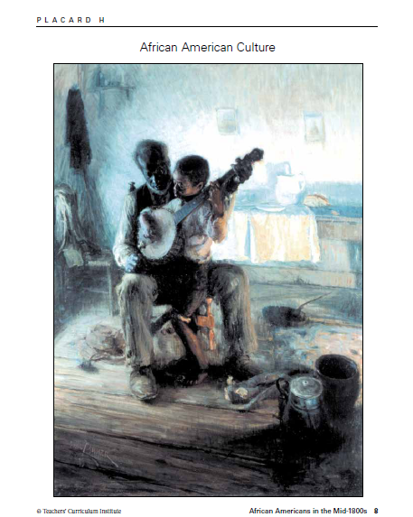
20.11 African American Culture
Quotation 3
Chorus:
Our bondage’ll have an end, by and by,
by and by.
Our bondage’ll have an end, by and by.
Jehovah rules the tide
And the waters he’ll divide,
Oh, the way he’ll open wide,
By and by.
Chorus:
From Egypt’s yoke set free
Hail the glorious jubilee,
Oh how happy we will be
By and by.
Chorus
Our Lord will save his own
By the power from his throne,
And old Pharaoh will drown
By and by.
—from a spiritual

